Slide 1
Introduction to Python Programming
Object Oriented Programming
Ms. Shital H. Dinde

Slide 2
Object Oriented Programming
In Python, object-oriented Programming (OOPs) is a programming paradigm that uses objects and classes in programming.
An object is any entity that has attributes and behaviors.
For example, a parrot is an object. It has
attributes - name, age, color, etc.
behavior - dancing, singing, etc.
Similarly, a class is a blueprint for that object.
The main concept of OOPs is to bind the data and the functions that work on that together as a single unit so that no other part of the code can access this data.

Slide 3
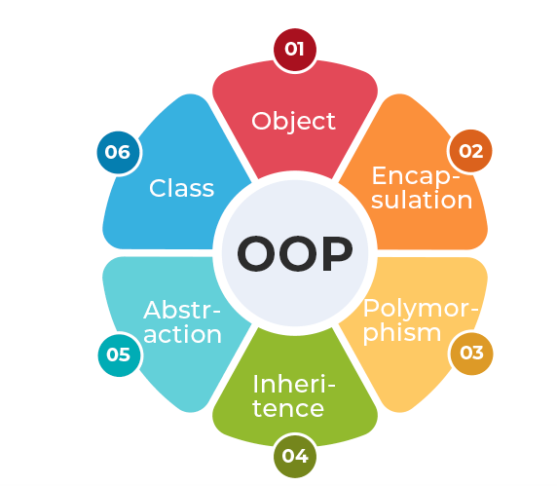
OOPs Concepts

Slide 4


Object Oriented Programming
Class:
A class contains the blueprints or the prototype from which the objects are being created.
It is a logical entity that contains some attributes and methods.
Classes are created by keyword class.
Attributes are the variables that belong to a class.
Attributes are always public and can be accessed using the dot (.) operator.
Eg.: Myclass.Myattribute
Syntax

Slide 5
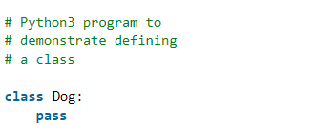
Object Oriented Programming
Creating an Empty Class

Slide 6


Object Oriented Programming
Objects:
The object is an entity that has a state and behavior associated with it.
An object consists of:
State: It is represented by the attributes of an object. It also reflects the properties of an object.
State or Attributes can be considered as the breed, age, or color of the dog.
Behavior: It is represented by the methods of an object. It also reflects the response of an object to other objects.
The behavior can be considered as to whether the dog is eating or sleeping.
Identity: It gives a unique name to an object and enables one object to interact with other objects.
The identity can be considered as the name of the dog.

Slide 7
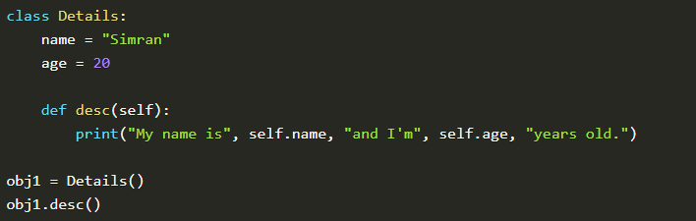
Object Oriented Programming
self
The self parameter is a reference to the current instance of the class, and is used to access variables that belongs to the class.
It must be provided as the extra parameter inside the method definition.
If we have a method that takes no arguments, then we still have to have one argument.
This is similar to this pointer in C++ and this reference in Java.
When we call a method of this object as myobject.method(arg1, arg2), this is automatically converted by Python into MyClass.method(myobject, arg1, arg2) – this is all the special self is about.

Slide 8
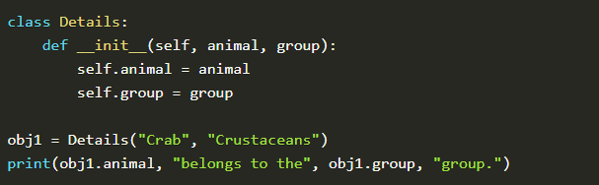
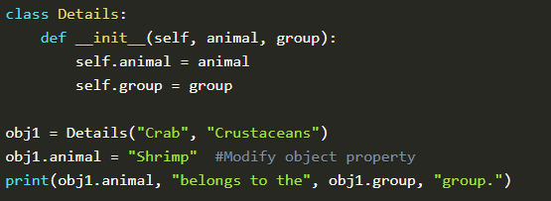
Object Oriented Programming
__init__ Method
The __init__ method is used to initialize the object’s state and contains statements that are executed at the time of object creation.
similar to constructors in C++ and Java.

Slide 9
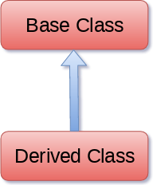

Object Oriented Programming
Inheritance
Inheritance is the capability of one class to derive or inherit the properties from another class.
The class that derives properties is called the derived class or child class and the class from which the properties are being derived is called the base class or parent class.
It represents real-world relationships well.
It provides the reusability of a code.
It is transitive in nature, which means that if class B inherits from another class A, then all the subclasses of B would automatically inherit from class A.
Inheritance offers a simple, understandable model structure.
Less development and maintenance expenses result from an inheritance.

Slide 10
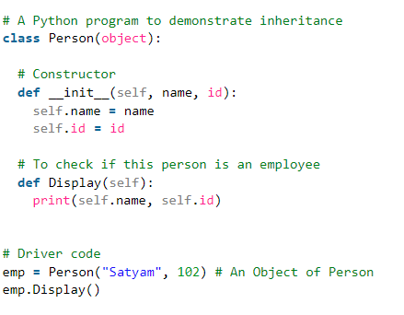
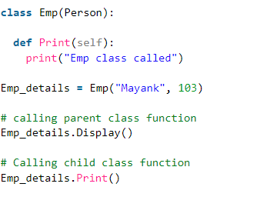
Object Oriented Programming
Example

Slide 11
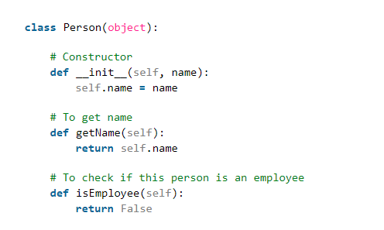
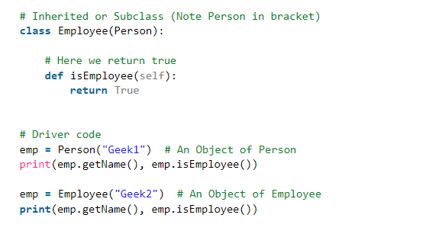
Object Oriented Programming
Example

Slide 12
Object Oriented Programming
Encapsulation
It describes the idea of wrapping data and the methods that work on data within one unit.
This puts restrictions on accessing variables and methods directly and can prevent the accidental modification of data.
To prevent accidental change, an object’s variable can only be changed by an object’s method. Those types of variables are known as private variables.
A class is an example of encapsulation as it encapsulates all the data that is member functions, variables, etc.
The goal of information hiding is to ensure that an object’s state is always valid by controlling access to attributes that are hidden from the outside world.

Slide 13
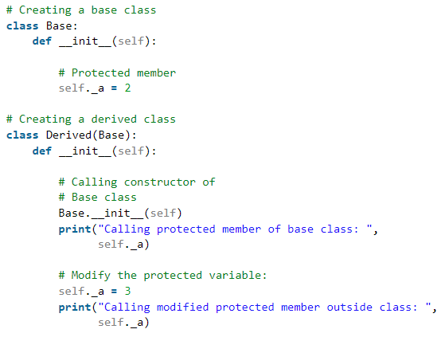
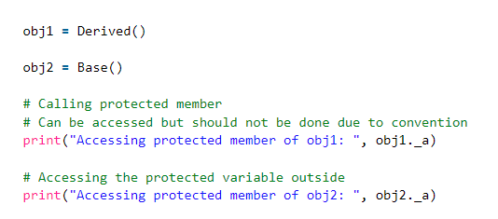
Object Oriented Programming
Protected members:
Protected members (in C++ and JAVA) are those members of the class that cannot be accessed outside the class but can be accessed from within the class and its subclasses.
by prefixing the name of the member by a single underscore “_”.

Slide 14
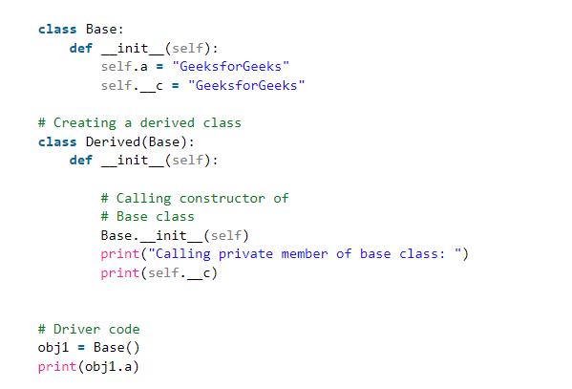
Object Oriented Programming
Private members
class members declared private should neither be accessed outside the class nor by any derived class.
Private instance variables that cannot be accessed except inside a class.
prefix the member name with double underscore “__”.

Slide 15
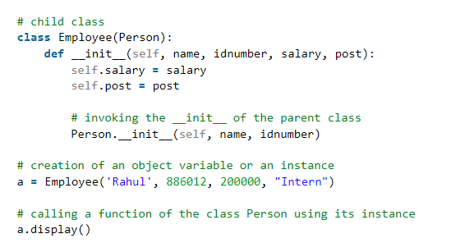
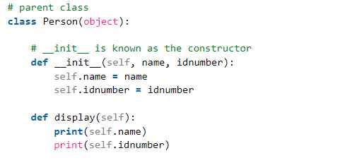
Object Oriented Programming
Calling constructor of parent class

Slide 16
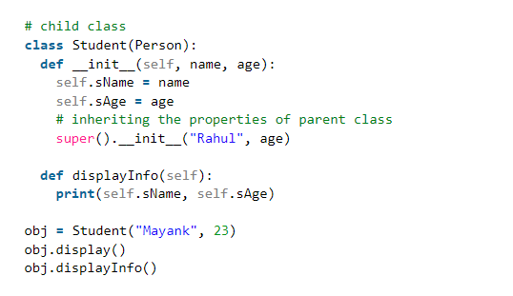
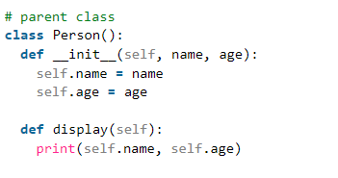
Object Oriented Programming
super() Function
returns the objects that represent the parent class.
It allows to access the parent class’s methods and attributes in the child class.

Slide 17
Object Oriented Programming
Types of Inheritance
Single Inheritance: Single-level inheritance enables a derived class to inherit characteristics from a single-parent class.
Multilevel Inheritance: Multi-level inheritance enables a derived class to inherit properties from an immediate parent class which in turn inherits properties from his parent class.
Hierarchical Inheritance: Hierarchical-level inheritance enables more than one derived class to inherit properties from a parent class.
Multiple Inheritance: Multiple-level inheritance enables one derived class to inherit properties from more than one base class.

Slide 18
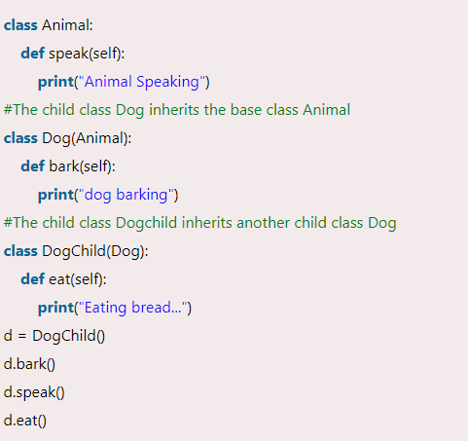
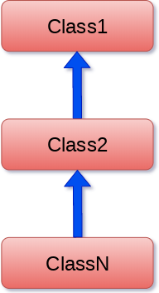
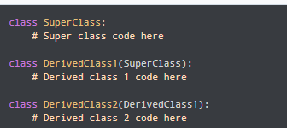
Object Oriented Programming
Multilevel inheritances:
child class will inherit from its parent class,
which in turn is inheriting from its parent class.

Slide 19
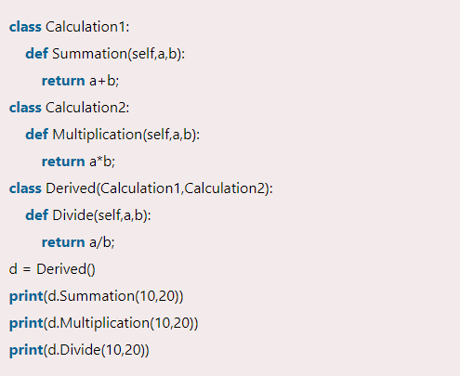
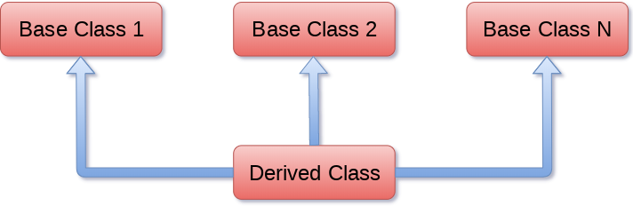
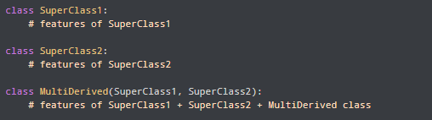
Object Oriented Programming
Multiple inheritances:
When a child class inherits from multiple
parent classes, it is called multiple inheritances.

Slide 20
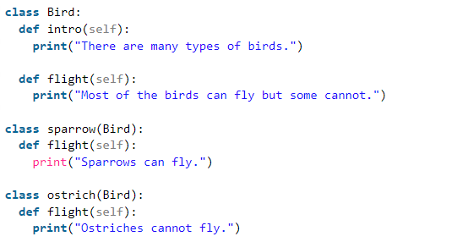
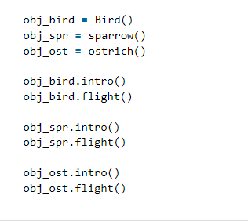
Object Oriented Programming
Polymorphism
Polymorphism simply means having many forms.
Can achieve this using Method Overriding

Slide 21
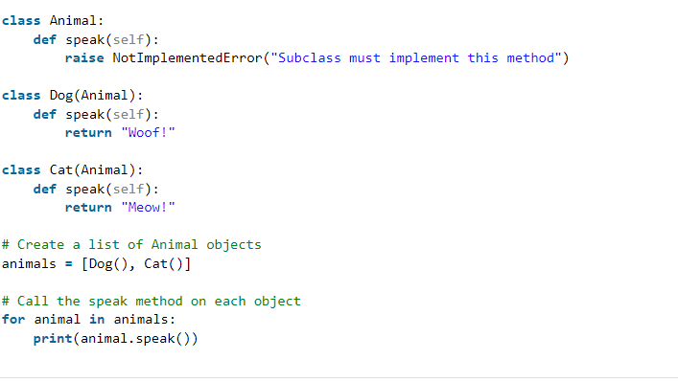
Object Oriented Programming
Method Overriding

Slide 22
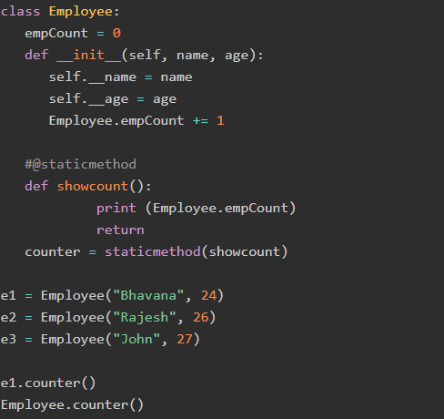
Object Oriented Programming
Static Methods:
static method doesn't have a mandatory
argument like reference to the object − self
or reference to the class − cls.
Python's standard library
function staticmethod() returns a static method.

Slide 23
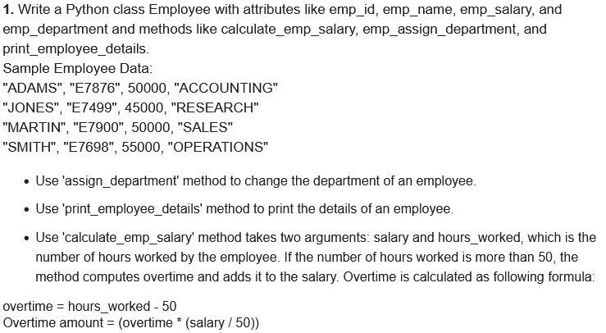
Object Oriented Programming
.

Slide 24
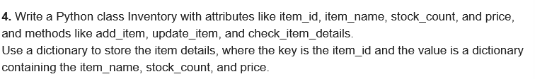
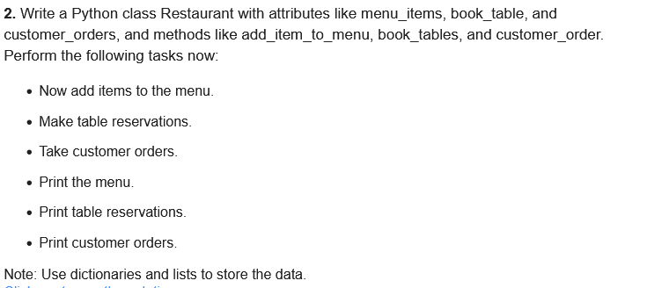
Object Oriented Programming
.

